Slide 1
Welcome
To
Hospital Management

Slide 2

SUBMITTED BY: PRINCE KUSHWAHA TEAM GROUP:
SUBMITTED TO: MR. ABHIMANYU MISHRA

Slide 3
INTRODUCTION
Hospital Management System is a project which aims in developing a computerized system to maintain all the information of hospital entities.
It has a facility of admin login through which the admin can monitor the whole system .
Patient modules are find doctors and applied for appointment, view appointment and view prescription.
Doctor modules are view our appointments, write prescriptions, and view patient details.

Slide 4
OBJECTIVE
The main objective of this project is to manage the records of patients, doctors and appointments.
Reduce the paper work and provide the 24*7 accessible website with user- friendly GUI (Graphical User Interface) to manage the records.
Our objective is by using this website patient can search and view doctors profiles and also apply for appointment.
This website project is also become useful for doctors for viewing patient’s details and write prescriptions to patients.

Slide 5
NEED OF THE SYSTEM
There is always a need of a system that will perform online searching of doctors and apply for appointment.
This system will reduce the manual operation required to maintain all the records and also generates the various reports for analysis.

Slide 6
purpose
purposeTo
manage the hospital administrative work. It helps to patients to find doctors detailed and take appointment online from anywhere.
This project also helps doctors work such as keep information of patient and appointment bookings and helps in giving prescriptions to patients.

Slide 7
Project scope
The project has a wide scope, as it is not intended to a particular organization .this project is going to develop generic software, which can be applied by any businesses organization. More over it provides facility to its users. Also the software is going to provide a huge amount of summary data

Slide 8
SOFTWARE USED
NOTEPAD++OR ANY OTHER TEXT EDITOR
CHROME OR ANY OTHER BROWSER

Slide 9
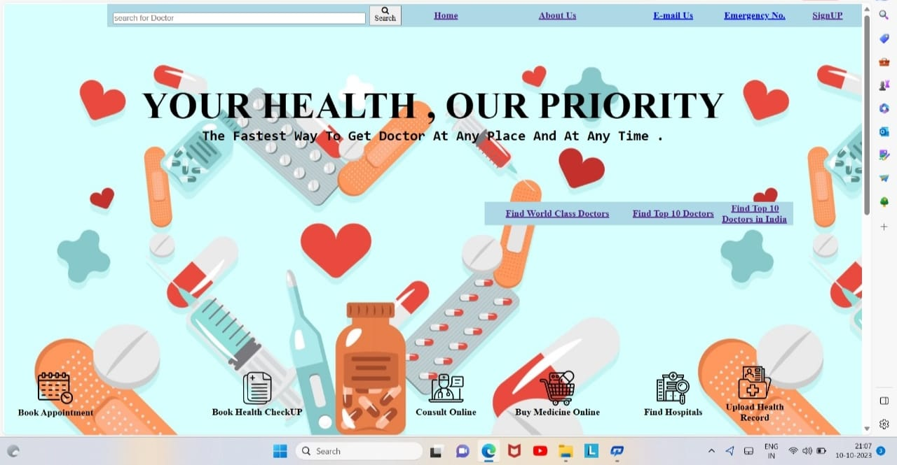
VIEW MY PRESCRIPTION PAGE

Slide 10
THANKYOU

